Slide 1
CEIS110 Module 2
Design and setup

Slide 2
Rubric
Activity | Requirement(s) | Points
Develop Flowchart | Flowchart | 15
Python program | Screenshot of python program | 15

Slide 3
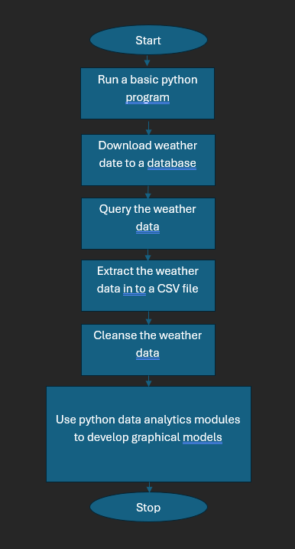
Flowchart
Include the following processes:
Run a basic python program
Download weather data to a database.
Query the weather data
Extract weather data from database into a comma separated file with python
Cleanse weather data
Use python data analytics modules to develop graphical models

Slide 4
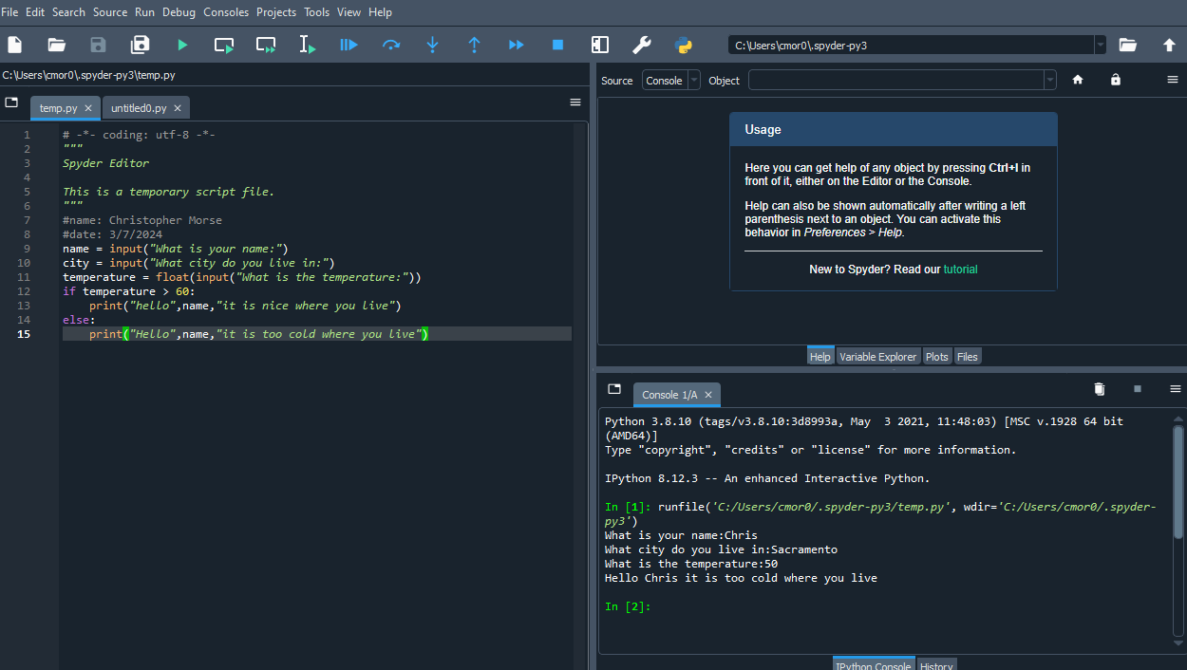
Python program (Screenshot)
Include screenshot of successful python program

